Slide 1
Crowdsourcing Pareto-Optimal Object Finding by Pairwise Comparisons
Abolfazl Asudeh, Gensheng Zhang, Naeemul Hassan, Chengkai Li, Gergely V. Zaruba
Department of Computer Science and Engineering
University of Texas at Arlington
CIKM, October 21, 2015, Melbourne, Australia
©2015 The University of Texas at Arlington. All Rights Reserved.

Slide 2
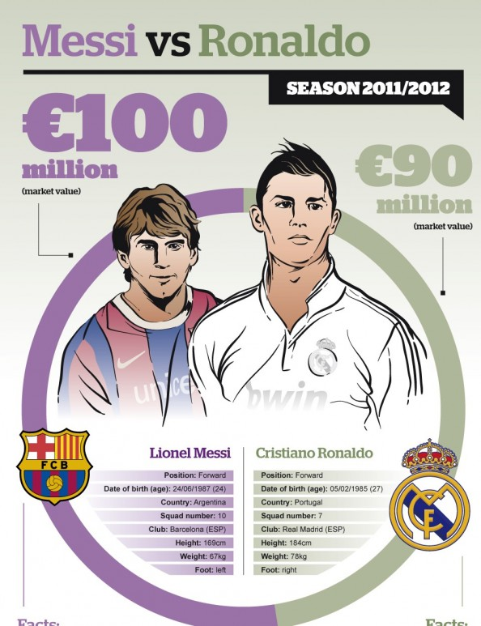


Humans’ Obsession: Comparing Things
Who is the better footballer?
Which is the better company to work for?
http://visual.ly/messi-vs-ronaldo
©2015 The University of Texas at Arlington. All Rights Reserved.

Slide 3
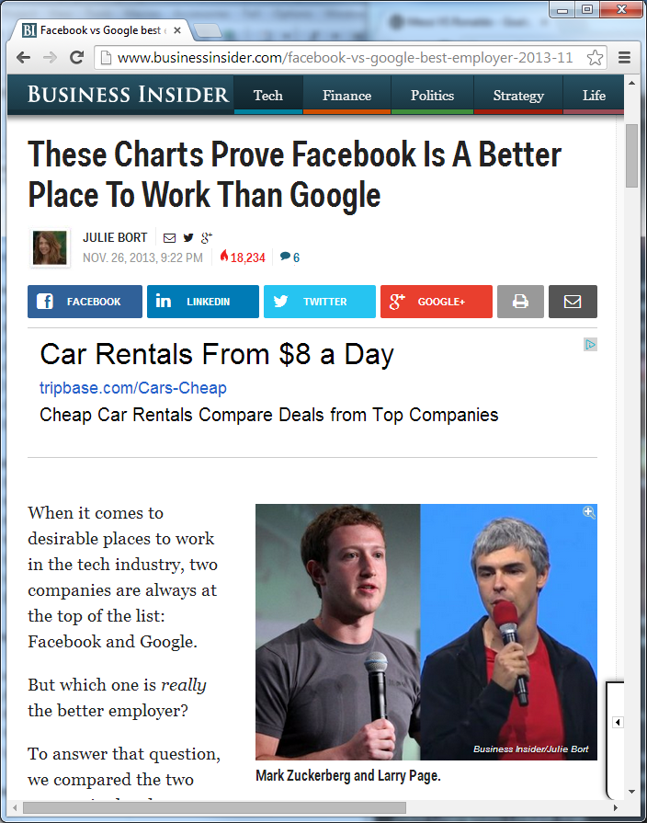
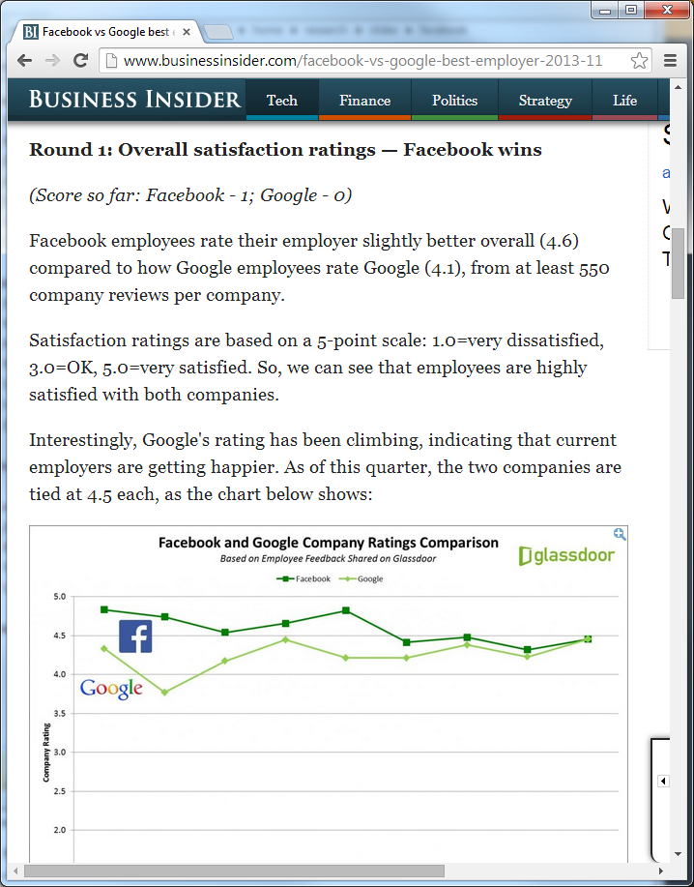
Facebook vs. Google
http://www.businessinsider.com/facebook-vs-google-best-employer-2013-11
©2015 The University of Texas at Arlington. All Rights Reserved.

Slide 4
Facebook vs. Google
Multiple criteria
Overall satisfaction | CEO approval | Employee confidence in the future | Perks and salaries | Interview difficulty
≻
≻
≻
≻
≻
Which one is better?
©2015 The University of Texas at Arlington. All Rights Reserved.

Slide 5
Overview
Ask crowd to compare objects on individual criteria
Derive partial knowledge about preference relations based on responses from crowd
Find all Pareto-optimal objects without exhausting all possible comparison questions
General framework and its instantiations (algorithms), with the goal of minimizing number of questions

Slide 6
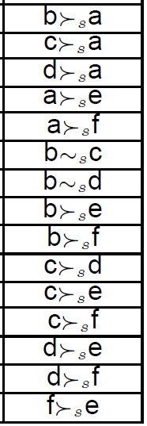
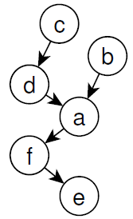
Preference (Better-Than) Relation P_{c}
(x , y) ∈ P_{c} (or x ≻_{c} y)
“x is better than (preferred over) y with regard to criterion c”
Assumptions on data model:
P_{c} is a strict partial order (as opposed to a total order)
Irreflexivity, Transitivity, Asymmetry
No explicit attribute representation,
thus no equivalence on a criterion
Notations:
(indifferent) x ∼_{c} y ⇔ (x, y) ∉ P_{c} ∧ (y, x) ∉ P_{c}
(not better than) x ⊁_{c} y ⇔ (x, y) ∉ P_{c}

Slide 7
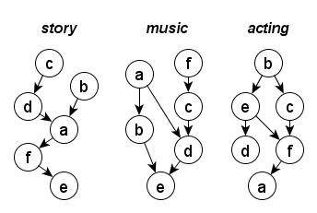
Pareto-optimal Objects
Object dominance: consider objects O, criteria C
y ≻ x ⇔ ∀c ∈ C : x ⊁_{c} y and ∃c ∈ C such that y ≻_{c} x (i.e., x is not better than y by any criterion and y is better than x by at least one criterion)
x ∈ O is Pareto-optimal ⇔ x is not dominated by any other object
Example:
c ≻ d ⇐ c ≻_{story} d, c ≻_{music} d, c ∼_{acting} d
Only one Pareto-optimal object: b

Slide 8
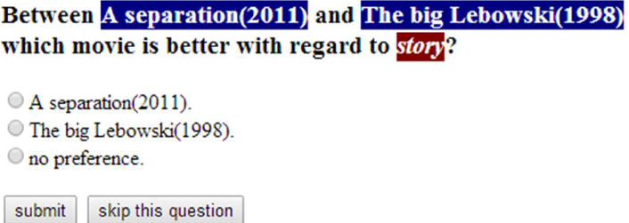
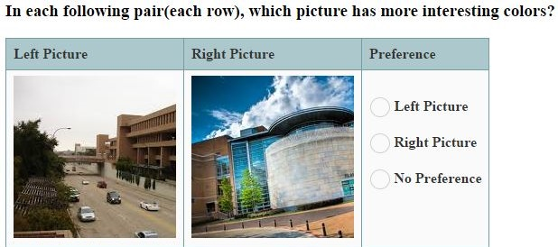
Deriving Preference Relations by Aggregating Crowd’s Responses to Pairwise Comparisons

Slide 9
Pareto-Optimal Object Finding
Problem statement: Given objects O and criteria C, find all Pareto-optimal objects, using pairwise comparisons by individual criteria
Cost metric
Goal: as few pairwise comparison questions as possible
Simple, but reflect real-world monetary cost and time delay
Brute-force approach : |C| x |O| x (|O|-1)/2 questions
Assumptions on execution model
Sequential execution: get rlt(q_{i}) before asking q _{i+1}
No consideration of worker quality

Slide 10
Applications
Collecting Public Opinion
Best companies to work for, best cities to live in
Group Decision Making
Where for lunch, which product to use, which candidate to hire
Information Exploration
Compare photos by color, sharpness, and landscape
Back to the “which one is better”?
After finding Pareto-optimal objects, further actions (ranking, filtering, visualization) to find desirable objects

Slide 11
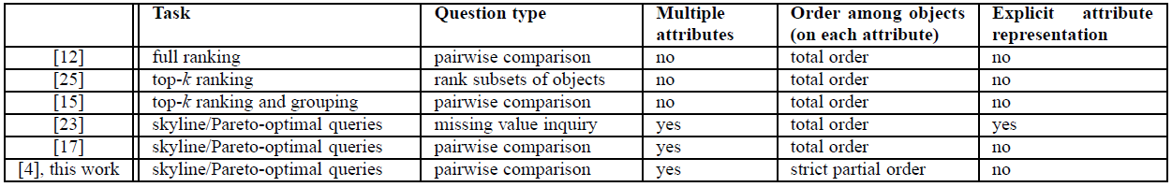
Related Work
[12] Chen et al. WSDM13 || [15] Davidson et al. ICDT13 || [17] Grozet al. PODS15 || [23] Lofi et al. EDBT13 || [25] Polychronopoulos et al. WebDB13 || [ 4] technical report of this paper
Other related work: collaborative filtering, learning to rank, …

Slide 12
Related Work
Explicit attribute representation
Total order on ordinal attributes (sizes of houses, ratings of restaurants), Partial-order on categorical attributes (genres of movies)
Not always easy to model and/or for users to provide missing values (e.g., story of movies)
Pairwise comparisons
Known to be easier, faster, and less error-prone. Widely used in social choice and welfare, preferences, and voting
Partial order vs. Total order
A direct effect of using pairwise comparisons
Not always natural to enforce a total order

Slide 13
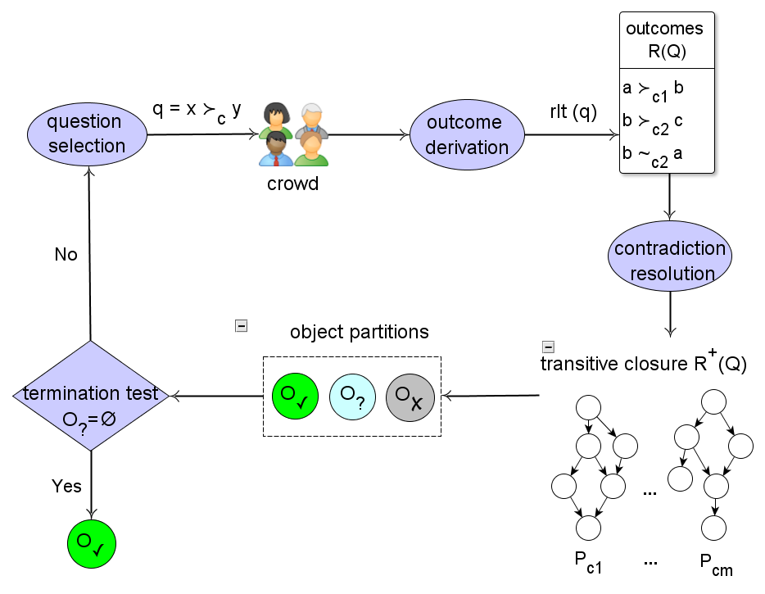
General, Iterative Algorithm Framework
4-steps in each iteration
(1) Question selection
(2) Outcome derivation
(3) Contradiction resolution
(4) Termination test

Slide 14
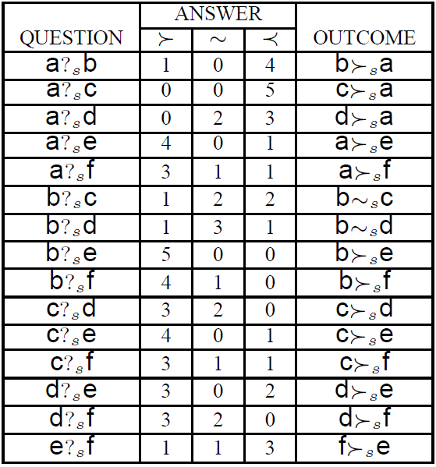
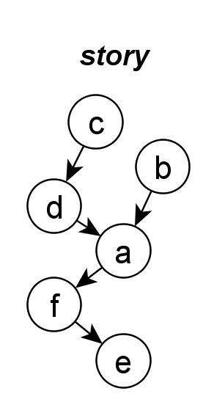
(2) Outcome Derivation
The framework is agnostic to the outcome derivation method. Other conceivable method can be plugged in.
Question
q = x ?_{c} y (compare x and y by criterion c)
Three possible outcomes based on voting
x ≻_{c} y
rlt(q) = y ≻_{c} x
x ∼_{c} y
{

Slide 15
(3) Contradiction Resolution
Assume transitivity in preference relation, and enforce it.
x
case 1
y
z
criterion c

Slide 16
(3) Contradiction Resolution
Assume transitivity in preference relation, and enforce it.
x
case 1
y
assumed
z
criterion c

Slide 17
(3) Contradiction Resolution
Assume transitivity in preference relation, and enforce it.
x
x
~
y
case 1
y
assumed
case 2
z
z
criterion c
criterion c

Slide 18
(3) Contradiction Resolution
Assume transitivity in preference relation, and enforce it.
x
x
~
y
~
case 1
y
assumed
case 2
assumed
z
z
criterion c
criterion c

Slide 19
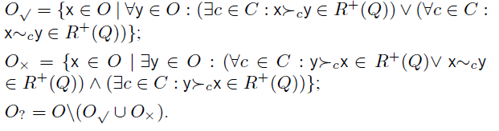
(4) Termination Test
At the end of each iteration, objects are partitioned into 3 sets, based on incomplete preference relations R⁺(Q) so far.
O√ : Pareto-optimal objects
O× : Non Pareto-optimal objects
O? : R⁺(Q) is insufficient for discerning these objects’ Pareto-optimality
O? = ∅ ⇒ terminate

Slide 20
(1) Question Selection
The process of executing a question sequence Q = ⟨q1, ..., qn⟩
Q is a terminal sequence if O? = ∅ based on R⁺(Q).
Goal: among many terminal sequences, execute a short sequence
Lower bound
Theorem 2: At ldeast (|O|−k)×|C|+(k−1)×2 pairwise comparison questions are necessary, where k is the number of Pareto-optimal objects.
Bad news
Worst-case : |C| x |O| x (|O|-1)/2 questions; cannot do better than brute-force
E.g., suppose all objects are indifferent by every criterion. If any comparison x ?_{c} y is skipped, we will not be able to determine if x and y are indifferent or if one dominates another.

Slide 21
Transitivity of Object Dominance: Doesn’t Hold
A cost-saving property for skyline queries
Object dominance transitivity: x ≻ y, y ≻ z ⇒ x ≻ z
Immediately prune a dominated object from further comparison. (Any object dominated by y is also dominated by x.)

Slide 22
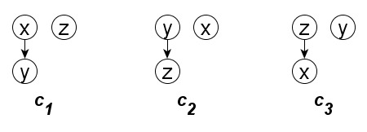
Transitivity of Object Dominance: Doesn’t Hold
Fundamental reason: lack of explicit attribute representation
In skyline/preference queries:
on any attribute, x >= y, y>=z ⇒ x>=z.
In Pareto-optimal object finding:
x ≻_{c} or ∼_{c} y, y ≻_{c} or ∼_{c} z ⇒ x ≻_{c} or ∼_{c} z (not true)
Even possible that an object is dominated by only one non-Pareto optimal object.

Slide 23
Can Still Benefit From A Similar Idea
For a non-Pareto optimal object, we only need to know at least one object dominates it. We don’t care about which other objects also dominate it.
Overriding principle of the framework:
Identify non-Pareto objects as early as possible
Postpone their comparisons with other objects as much as possible

Slide 24
Candidate Questions
Given asked questions Q = ⟨q1, ..., qn⟩, x ?_{c} y is a candidate question iff it satisfies 3 conditions:
(i) The outcome of x ?_{c} y is unknown yet, i.e., rlt(x ?_{c} y) ∉ R⁺(Q)
(ii) x ∈ O?
(iii) Based on R+(Q), y ≻ x is not ruled out yet.
How to rule out y ≻ x ?
∃c∈C such that x ≻_{c} y ∈ R⁺(Q) ⇒ y⊁x

Slide 25
Only Choosing from Candidate Questions
Sufficient
Property 2: Qcan = ∅ ⇔ O? = ∅
Efficient
Theorem 1: If Q contains non-candidate questions, there exists a shorter or equally long sequence Q’ without non-candidate questions such that Q’ finds at least all dominated objects found by Q.

Slide 26
Macro-ordering, Micro-ordering
Both guided by the overriding principle
Macro-ordering: When available, we choose a candidate question x ?_{c} y such that y ∉ O×
Micro-ordering: Several question ordering heuristics:
Random Question (RandomQ): randomly choose a candidate question x ?_{c} y
Random Pair (RandomP): randomly choose a candidate question x ?_{c} y, continue to finish all remaining candidate questions between x and y.
Fewest Remaining Questions (FRQ): Choose a pair with the fewest remaining questions. Ties are broken based on how many objects are better/worse than x and y on the criterion.

Slide 27
Experiments by Simulation
Used an 10000-tuple NBA dataset that records players’ per-season performance on 10 criteria (points-per-game, …)
Simulated Partial orders based on players’ performance comparison, with some perturbations.

Slide 28
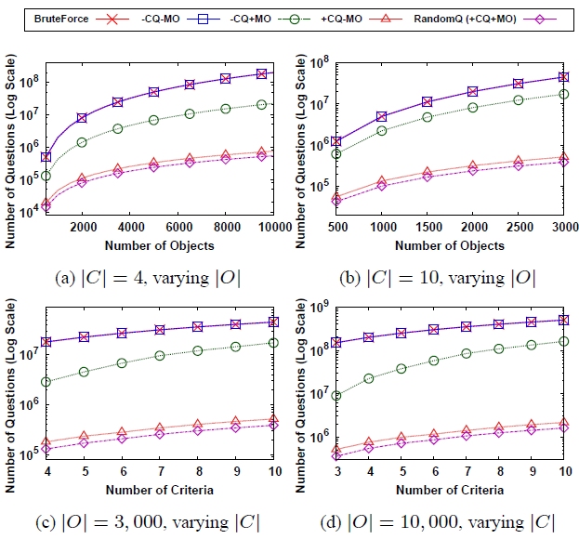
Effectiveness of Candidate Questions and Macro-Ordering

Slide 29
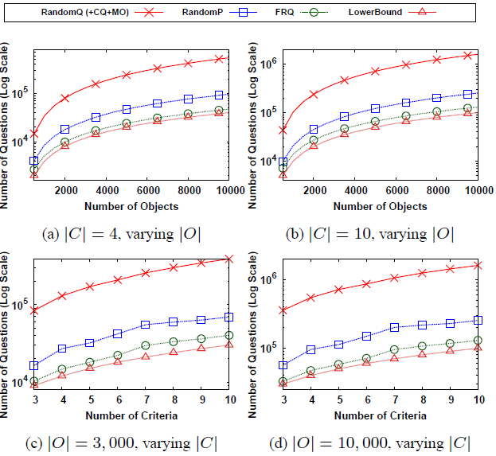
Effectiveness of Micro-Ordering

Slide 30
Experiments using Amazon Mechanical Turk
Compare 100 photos of UT-Arlington campus, by color, sharpness, landscape.
All 14, 850 possible pairwise questions were partitioned into 1, 650 tasks, each containing 9 questions on a criterion.
Worker qualification:
responded to at least 100 HITs before with at least 90% approval rate
2 additional validation questions mixed in each task

Slide 31
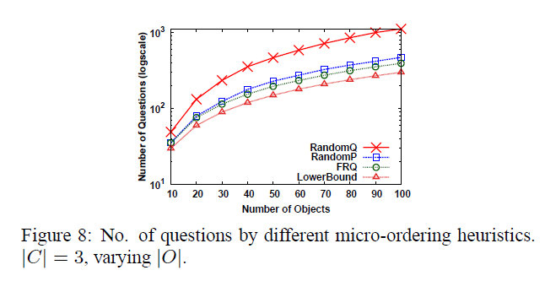
Experiments using Amazon Mechanical Turk

Slide 32
Limitations and Future Work
No performance guarantee: as bad as brute-force in worst-case
Non-deterministic results: due to contradiction resolution
Possibly empty result: due to lack of object dominance transitivity
No consideration of different levels of confidence on question outcomes or crowdsourcers' quality.
Future work: Pareto-optimal objects in probabilistic sense?
No consideration of parallel/batch-execution scheme
Future work: Parallel scheme

Slide 33
Thank You! Questions?
Chengkai Li
http://ranger.uta.edu/~cli
cli@uta.edu
©2015 The University of Texas at Arlington. All Rights Reserved.

Slide 34
(3) Contradiction Resolution
How often does contradiction happen?
Depends on data itself, k, and θ
It may not happen a lot.
Intuitively: as long as the underlying relation is transitive, collective wisdom of crowd should reflect it.
Preference judgments of relevance in document retrieval are transitive [27, 11].

Slide 35
Brute-Force on the Toy Example
6 objects, 3 criteria: 45 comparisons

Slide 36
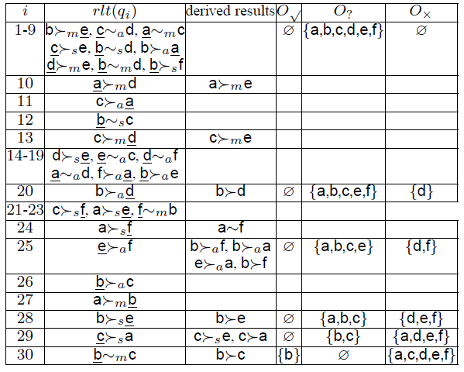
RandomQ on the Toy Example

Slide 37
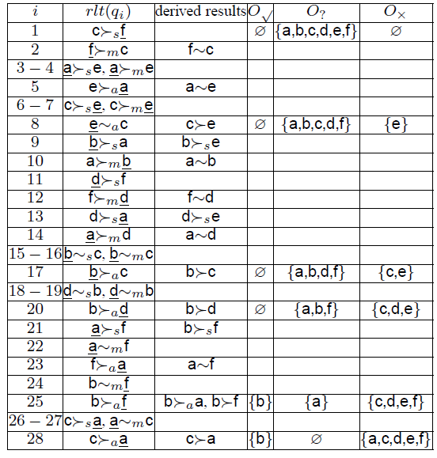
RandomP on the Toy Example

Slide 38
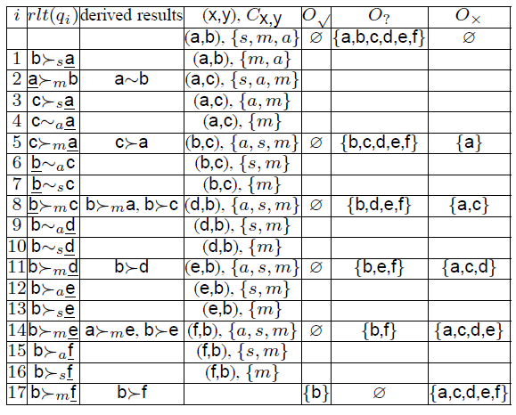
FRQ on the Toy Example

